Slide 1
Region IV Webinar – July 15, 2014
Understanding Performance Report Trends
Ken Tanner DTM, PID

Slide 2
Performance Report Trends
Outline
What are these Trends
What is included
How can they be useful to you
Taking a look at the Trends
Something Extra !
Questions, comments, suggestions, etc
Wrap up

Slide 3
What are these Trends?
They chart progress toward Distinguished District on certain Critical Success factors
  Member Payments
  New Members
  Paid Clubs
  CC’s
  AC’s
Month by Month actual, compared to prior years
Charts and graphs provided, updated monthly

Slide 4
Extra reading?
Well, not really extra reading … ☺
A few paragraphs of details about these Performance Trends are now posted at the bottom of the Performance Trends page
Content is posted by PID Cliff Heinsch (D6)

Slide 5
How can they be useful to you
Can provide an ‘early warning’ signal
Watch for current performance appearing less than prior years
Compare to years where Distinguished Status was achieved
Compare also to either 4 year average, or the 7 year average
Challenge is to watch the comparisons and determine early enough where action is needed
Action could be new incentives, publicity, recognition, etc. in the District to provide encouragement

Slide 6
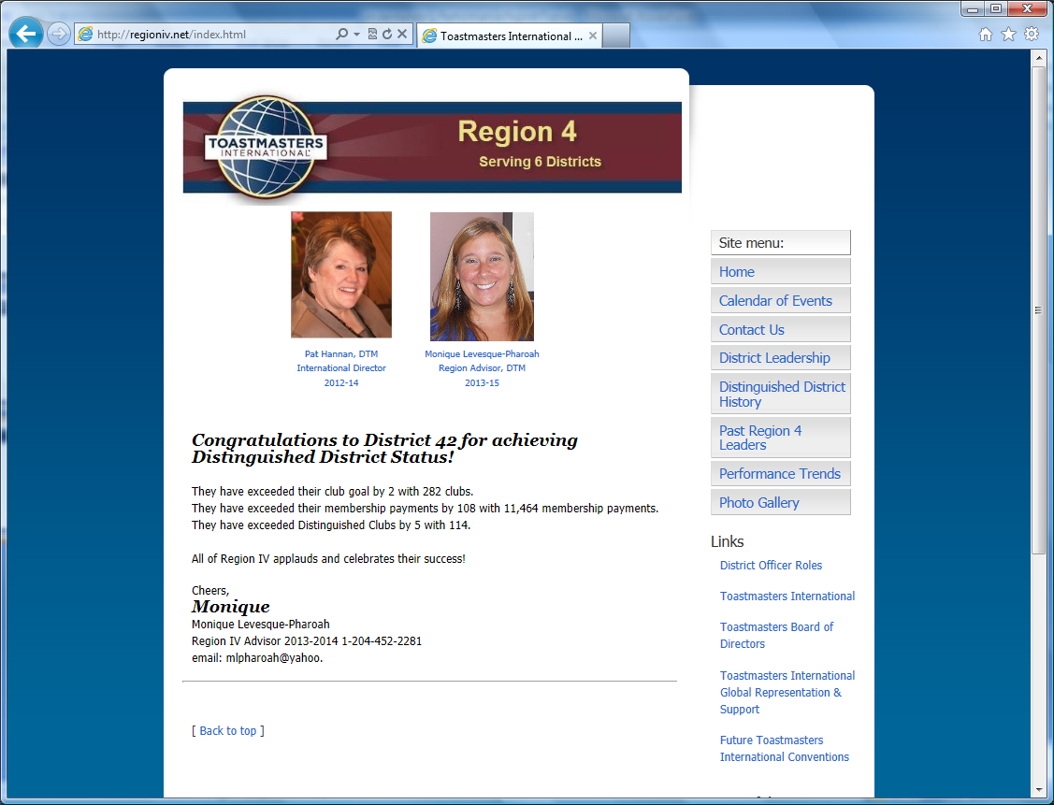
Finding the Performance Trends

Slide 7
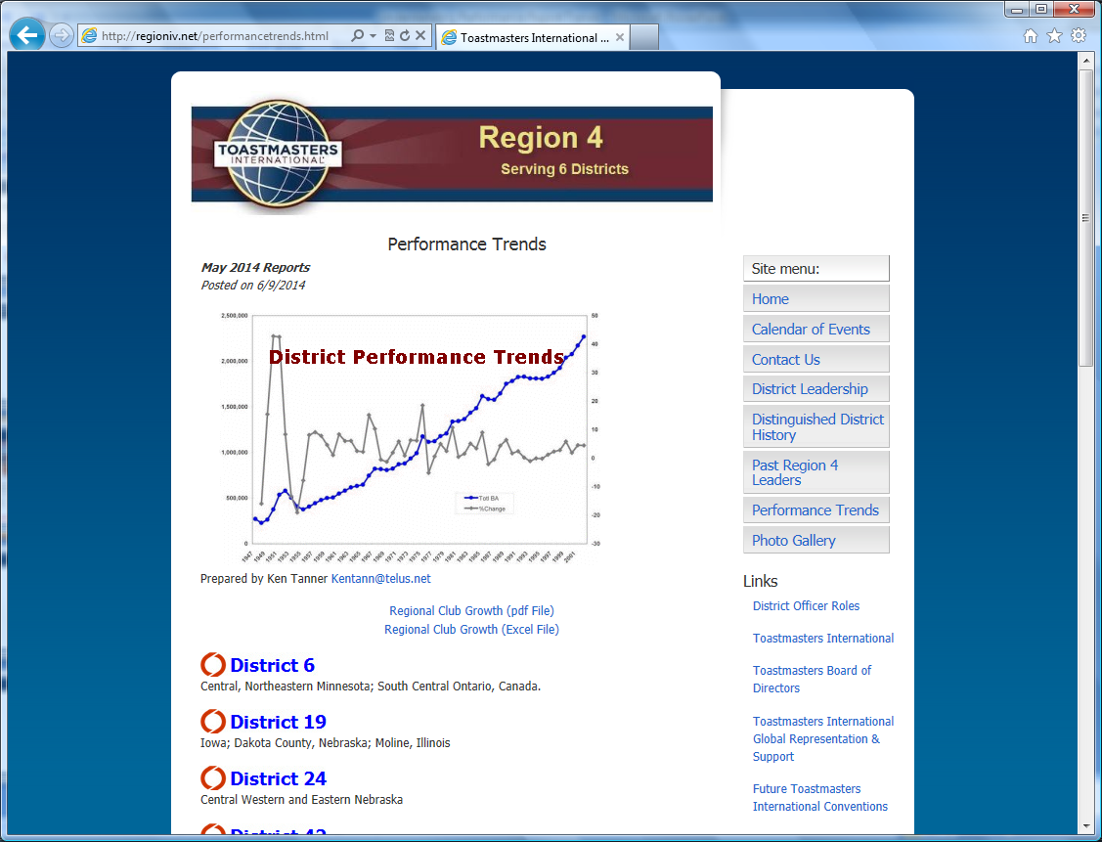
You’ve found them !

Slide 8
Options to view
Three ways to view:
Web view
Excel view and/or download
PDF view and/or download
Available for each of our Districts, plus a Region Summary
Also available - Year end reports going back to June 30, 2004

Slide 9
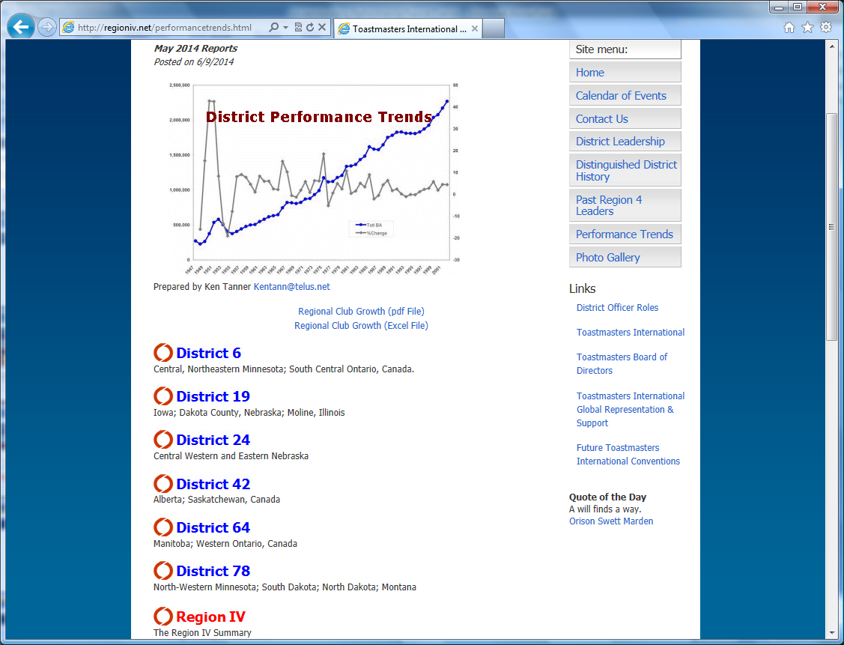
Find your District

Slide 10
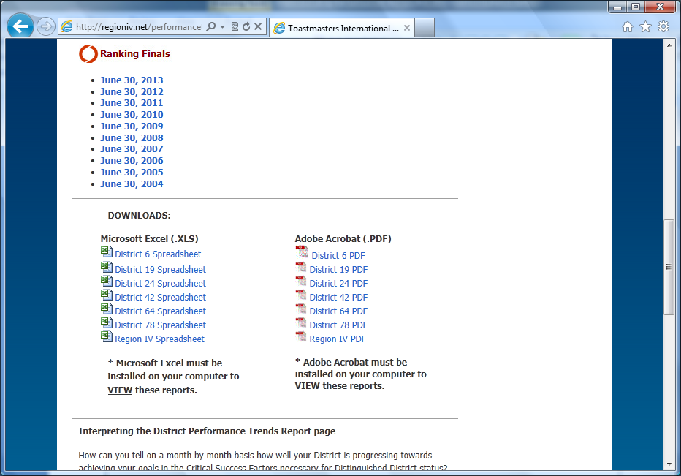
Finding the Excel and PDF files

Slide 11
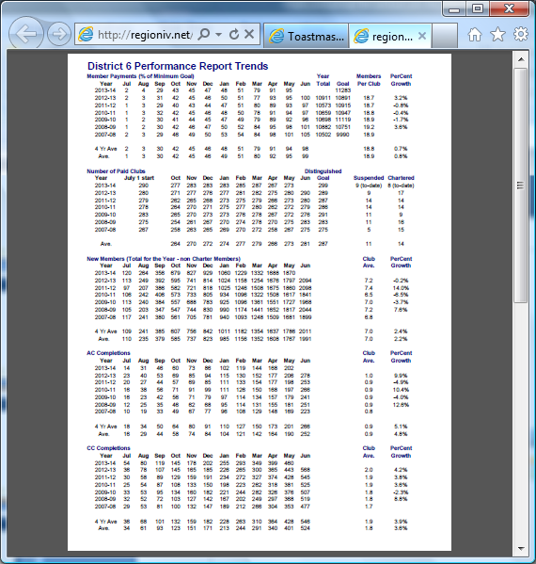
Let’s take a look !

Slide 12
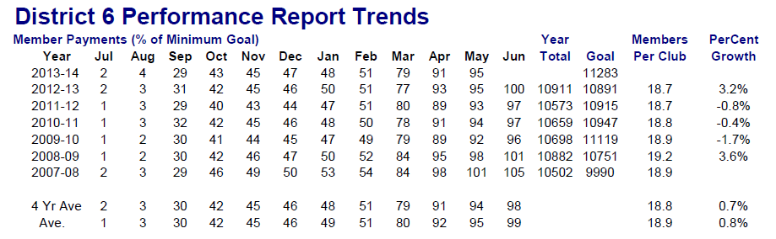
Member Payments Block
Years when June was 100% or more, those are years for valuable comparison purposes
Years when member payment goal was achieved had January % at 50% or more (dependent upon volume of new clubs chartered after January)
NOTE – the Club Average ‘math’ → total divided by # of clubs at yearend

Slide 13
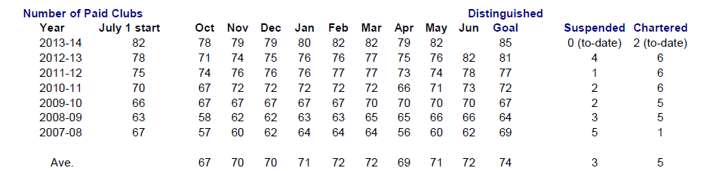
Paid Clubs block
Content
  July 1 start
  Month by Month paid club total
  Distinguished Goal
  Number of suspended clubs
  Number of new Charters

Slide 14
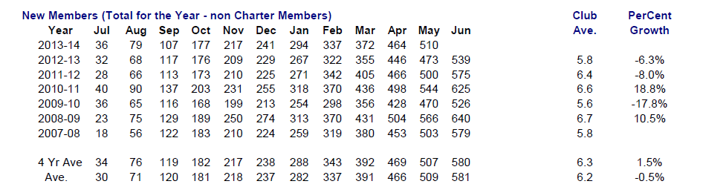
New Members Block
Shows a month by month total of new members enrolled into existing clubs (thus – non Charter members)
in Region IV, the biggest new member enrollment months are October and April, almost double the amount in those two months compared to other months
About 20% of year end member payments total comes from New Member enrollments

Slide 15
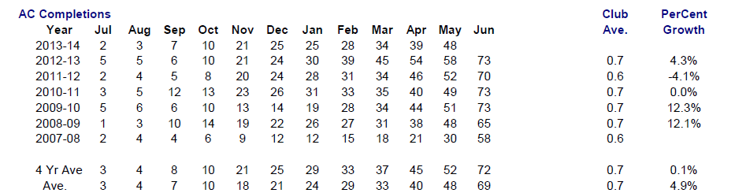
AC Completions block
Shows the month by month total of AC registrations
Included since these are two critical goals for club DCP

Slide 16
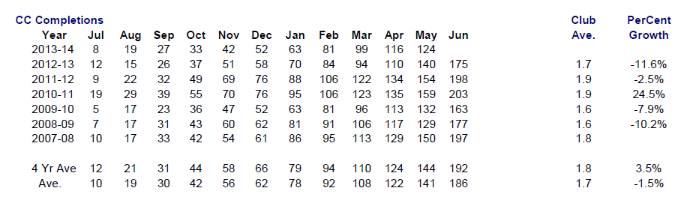
CC Completions block
Similar to the AC Completions block
  Shows the month by month total of CC registrations
  Included since these are two critical goals for club DCP

Slide 17
And it’s all graphed too !
Each block of information is also provided in Graph form

Slide 18
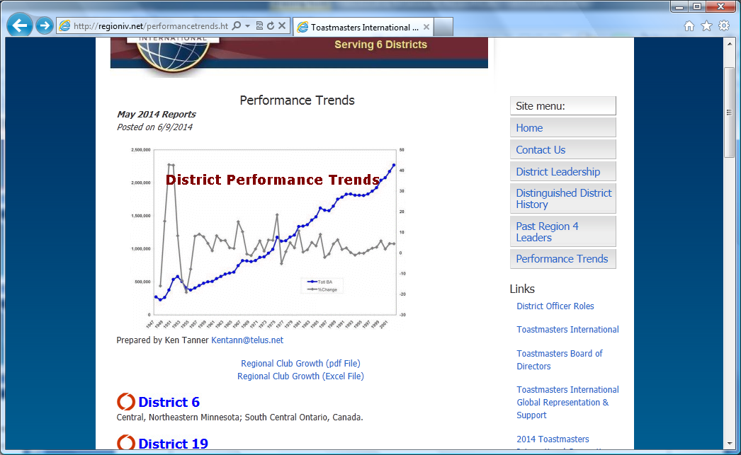
Club Growth chart as well !

Slide 19
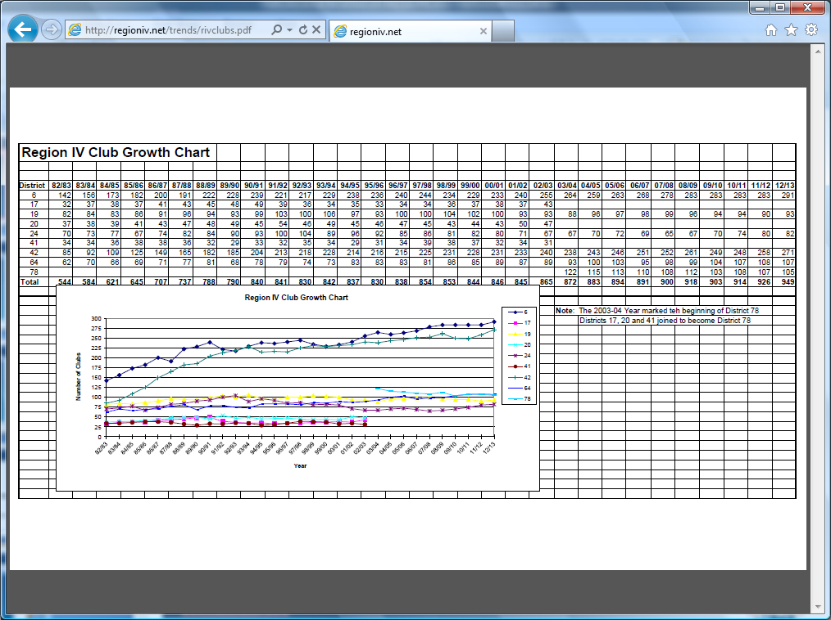
The club growth chart

Slide 20
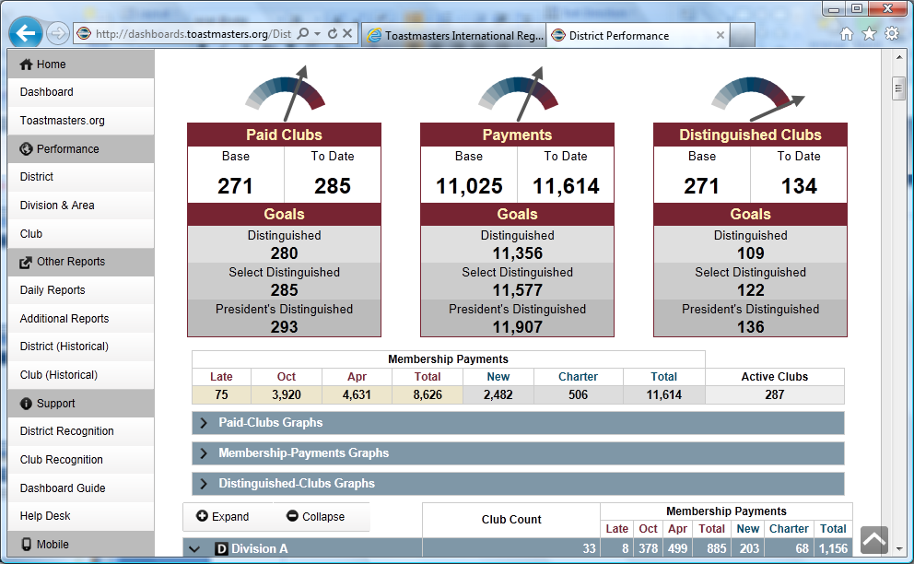
New chart resources on TI website

Slide 21
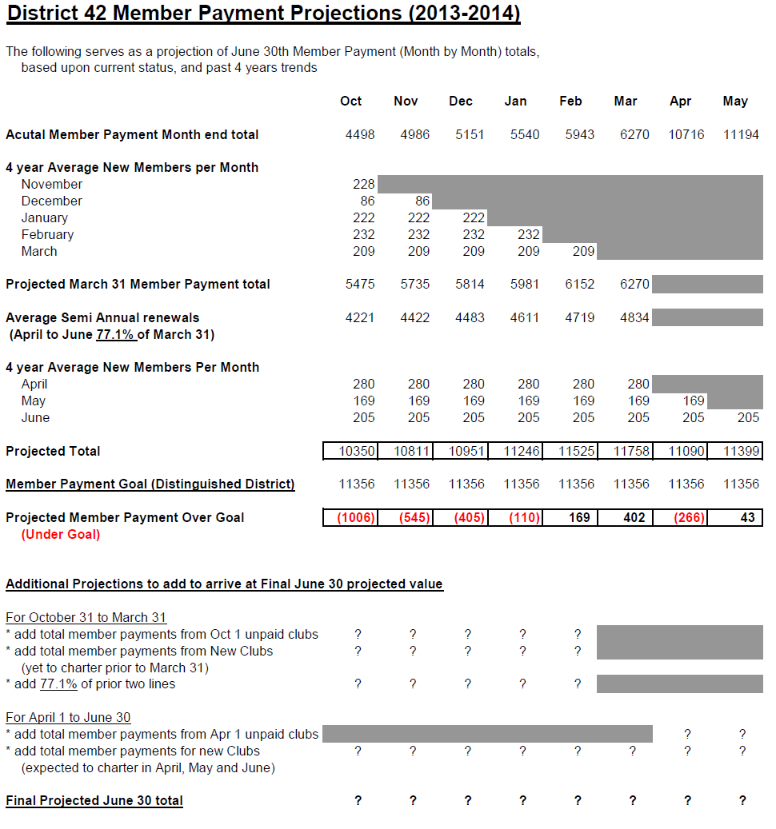
Something ‘Extra’ - How to project your year end Member Payments total

Slide 22
And it’s over to you now...
Questions?
Comments?
Confusion? ☺
Suggestions?

Slide 23
That’s all folks !
This power point will be posted on the Trends page for your future reference
Have a Great Year !
Ken Tanner DTM, PID
kentann@telus.net

